Slide 1

E-COMMERCE
J.Sheeba Selvapattu
JAIN (DEEMED-To-Be)University

Slide 2
Computer networking

Slide 3

INTRODUCTION:
We are living in the computer age. Computer is the most appropriate representative of man’s intelligence and wisdom.
Computers are not to replace the human intelligence and memory but assist humanity in its task of collecting, memorizing and analyzing the information. It is used to perform millions of computations in just a few seconds. It is used to store large volumes of information for future use.
Thus the desirable characteristics of computers are their speed, storage capacity, and accuracy.
Computer revolution has found its way into, almost every aspect of human life and living.

Slide 4
Computer networking
A computer network is a collection of computing devices that are connected with each other for the purpose of information and resource sharing among a wide variety of users.
Each device in the network is called a node which is connected to other nodes through wired or wireless media.
Computers connected with each other through wires, optical fibres or optical links so that various devices can interact with each other through a network.

Slide 5
The features of a computer network are −
Sharing −
Computer networks enable sharing of files, software, hardware resources and computing capabilities.
Speed:
The communication speed among the components is fast
Scalability −
Sizes of computer networks dynamically increase with time. The networks have to be scalable so that they can evolve adequately for future deployments.

Slide 6
Security −
Networks allow security and access rights to the users for restricted sharing of resources and information.

Slide 7
hardware's required to set up a computer network.
Network Cables
Distributors
Routers
Internal Network Cards
External Network Cards

Slide 8
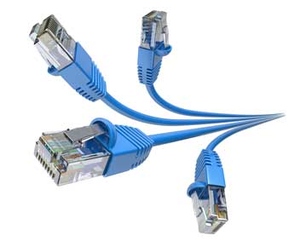
Network Cables
Network cables are used to connect computers.

Slide 9
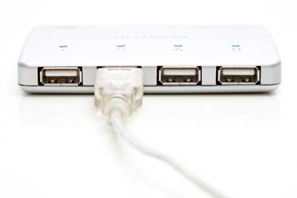
Distributors
A computer can be connected to another one via a serial port but if we need to connect many computers to produce a network, this serial connection will not work.
The solution is to use a central body to which other computers, printers, scanners, etc. can be connected and then this body will manage or distribute network traffic.

Slide 10
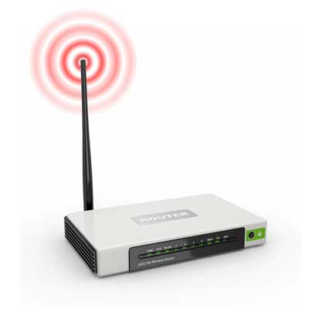
Router
A router is a type of device which acts as the central point among computers and other devices that are a part of the network. It is equipped with holes called ports. Computers and other devices are connected to a router using network cables. Now-a-days router comes in wireless modes using which computers can be connected without any physical cable.

Slide 11
Network Card
Network card is a necessary component of a computer without which a computer cannot be connected over a network. It is also known as the network adapter or Network Interface Card (NIC). Most branded computers have network card pre-installed. Network cards are of two types: Internal and External Network Cards.

Slide 12
Universal Serial Bus (USB)
USB card is easy to use and connects via USB port. Computers automatically detect USB card and can install the drivers required to support the USB network card automatically.

Slide 13
Uses Of Computer Network
Resource sharing:
Resource sharing is the sharing of resources such as programs, printers, and data among the users on the network without the requirement of the physical location of the resource and user.
Server-Client model:
Computer networking is used in the server-client model. A server is a central computer used to store the information and maintained by the system administrator. Clients are the machines used to access the information stored in the server remotely.

Slide 14
Communication medium:
Computer network behaves as a communication medium among the users. For example, a company contains more than one computer has an email system which the employees use for daily communication.
E-commerce:
Computer network is also important in businesses. We can do the business over the internet. For example, amazon.com is doing their business over the internet, i.e., they are doing their business over the internet.

Slide 15
Computer Network Types
LAN(Local Area Network)
PAN(Personal Area Network)
MAN(Metropolitan Area Network)
WAN(Wide Area Network)

Slide 16
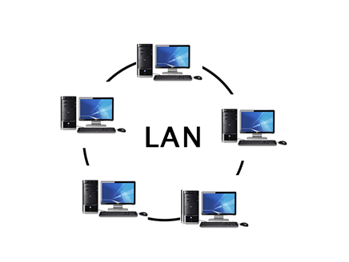
LAN(Local Area Network)
Local Area Network is a group of computers connected to each other in a small area such as building, office.
LAN is used for connecting two or more personal computers through a communication medium such as twisted pair, coaxial cable, etc.
The data is transferred at an extremely faster rate in Local Area Network.
Local Area Network provides higher security.
Usually, LAN covers an organization offices, schools, colleges or universities.
LAN provides a useful way of sharing the resources between end users. The resources such as printers, file servers, scanners, and internet are easily sharable among computers.

Slide 17
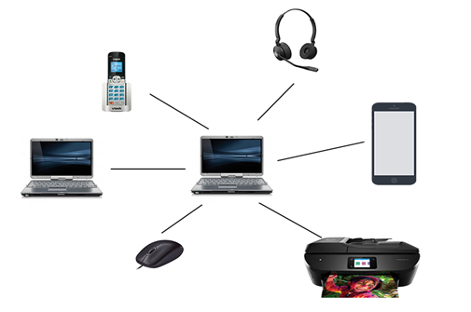
PAN(Personal Area Network)
Personal Area Network is a network arranged within an individual person, typically within a range of 10 meters.
Personal Area Network is used for connecting the computer devices of personal use is known as Personal Area Network.
Personal Area Network covers an area of 30 feet.
PAN may include wireless computer keyboard and mouse, Bluetooth enabled headphones, wireless printers, and TV remotes

Slide 18
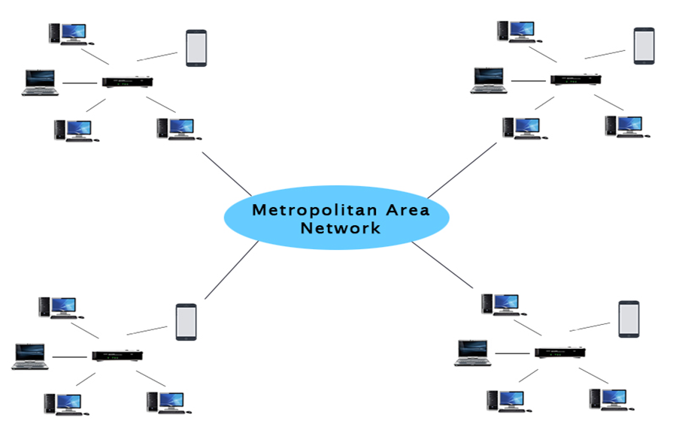
MAN(Metropolitan Area Network)
A metropolitan area network (MAN) is a computer network that connects computers within a metropolitan area, which could be a single large city, multiple cities and towns, or any given large area with multiple buildings.
A MAN is larger than a local area network (LAN) but smaller than a wide area network (WAN)
A metropolitan area network is a network that covers a larger geographic area by interconnecting a different LAN to form a larger network.

Slide 19
Uses Of Metropolitan Area Network:
MAN is used in communication between the banks in a city.
It can be used in an Airline Reservation.
It can be used in a college within a city.
It can also be used for communication in the military.

Slide 20
WAN(Wide Area Network)
A Wide Area Network is a network that extends over a large geographical area such as states or countries.
A Wide Area Network is not limited to a single location, but it spans over a large geographical area through a telephone line, fibre optic cable or satellite links.
The internet is one of the biggest WAN in the world.
A Wide Area Network is widely used in the field of Business, government, and education.
WANs have a large capacity, connecting a large number of computers over a large area, and are inherently scalable.
WAN includes the technologies to transmit data, image, audio and video information over long distances and among different LANs and MANs.

Slide 21
Examples Of Wide Area Network:
Mobile Broadband:
A 4G network is widely used across a region or country.
Last mile:
A telecom company is used to provide the internet services to the customers in hundreds of cities by connecting their home with fiber.
Private network:
A bank provides a private network that connects the 44 offices. This network is made by using the telephone leased line provided by the telecom company.

Slide 22
WHAT IS INTERNET?
Internet is a global network that connects billions of computers across the world with each other. It is set up by using cables such as optical fibers and other wireless and networking technologies. At present, internet is the fastest mean of sending or exchanging information and data between computers across the world.
It connects millions of computers, webpages, websites, and servers. Using the internet we can send emails, photos, videos, messages .
It creates a communication medium to share and get information online. If your device is connected to the Internet then only you will be able to access all the applications, websites, social media apps, and many more services.

Slide 23
USES OF INTERNET:
a) It provides the means to exchange data among computers and to make programs and data available to the people.
b) It permits the sharing resources of the machines.
c) It allows a flexible working environment.
d) It saves money.
e) It is used as a communication medium.
f) Businesses use internet to carry out electronic commerce.
g) Internet is used for voice and video conferencing and other forms of communication.
h) E-mail on internet has greatly speeded up the communication among companies and among individuals.

Slide 24
World Wide Web(WWW)
World Wide Web, which is also known as a Web, is a collection of websites or web pages stored in web servers and connected to local computers through the internet. These websites contain text pages, digital images, audios, videos, etc. Users can access the content of these sites from any part of the world over the internet using their devices such as computers, laptops, cell phones, etc.
For example, www.facebook.com is a URL of the facebook website
the world wide web is an information retrieval service of the web. It provides users a huge array of documents that are connected to each other by means of hypertext or hypermedia links.

Slide 25
. IP Addressing System
IP address stands for internet protocol address.
Every PC/Local machine is having an IP address and that IP address is provided by the Internet Service Providers (ISP’s).
Every laptop and desktop has its own unique IP address for identification. It’s an important part of internet technology.
An IP address is displayed as a set of four-digit like 192.154.3.29.
Here each number on the set ranges from 0 to 255. Hence, the total IP address range from 0.0.0.0 to 255.255.255.255.

Slide 26
Uniform Resource Locator (URL)
Uniform Resource Locator (URL) refers to a web address which uniquely identifies a document over the internet.
It is used to indicate the location of a web resource to access the web pages.
For example, to visit the Facebook website, you will go to the URL www.facebook.com, which is the URL for the Facebook website

Slide 27
Domain Names
Domain name is the identity of one or more IP addresses; for example, the domain name google.com points to the IP address "74.125.127.147". Domain names are invented as it is easy to remember a name rather than a long string of numbers.
It would be easy to enter a domain name in the search bar than a long sequence of numbers.
There are several domain names available; some of them are generic such as com, edu, gov, net etc,

Slide 28


Slide 29
WEB BROWSERS:
Web browsers are client software packages that allow the user to navigate through the World Wide Web and displays web pages.
Functions of web browsers:
It contacts a web server and sends a request for information.
It receives the information and then displays it on the user’s computer

Slide 30
Important Types of Web Browsers:
Internet Explorer
Internet Explorer (IE) is a product from software giant Microsoft. This is the most commonly used browser in the universe. This was introduced in 1995 .
Google Chrome
This web browser is developed by Google and its beta version was first released on September 2, 2008 for Microsoft Windows. Today, chrome is known to be one of the most popular web browser with its global share of more than 50%.
Mozilla Firefox
Firefox is a new browser derived from Mozilla. It was released in 2004 and has grown to be the second most popular browser on the Internet.

Slide 31
Safari
Safari is a web browser developed by Apple Inc. and included in Mac OS X. It was first released as a public beta in January 2003.
Opera
Opera is smaller and faster than most other browsers, yet it is full- featured. Fast, user-friendly, with keyboard interface, multiple windows, zoom functions, and more. Ideal for newcomers to the Internet, school children, handicap

Slide 32
HOW DOES INTERENT WORK?
The actual working of the internet takes place with the help of clients and servers. Here the client is a laptop that is directly connected to the internet and servers are the computers connected to the Internet and they are having all the websites stored in those large computers.
These servers are connected to the internet with the help of ISP (Internet Service Providers) and will be identified with the IP address.
Each website has its Domain name as it is difficult for any person to always remember the long numbers or strings. So, whenever you search any domain name in the search bar of the browser the request will be sent to the server and that server will try to find the IP address from the Domain name because it cannot understand the domain name.

Slide 33
After getting the IP address the server will try to search the IP address of the Domain name in a Huge phone directory that in networking is known as a DNS server (Domain Name Server)
So after getting the IP address the browser will pass on the further request to the respective server and now the server will process the request to display the content of the website which the client wants.
If you are using a wireless medium of Internet like 3g and 4g or other mobile data then the data will start flowing from the optical cables and will first reach to towers from there the signals will reach your cell phones and Pc’s through electromagnetic waves. And if you are using routers then optical fiber connecting to your router will help in connecting those light-induced signals into electrical signals and with the help of ethernet cables internet reaches your computers and hence the required information.

Slide 34
INTRODUCTION TO E-COMMERCE

Slide 35
INTRODUCTION:
Ecommerce, or electronic commerce, is the buying and selling of products or services via the internet. For many Americans, ecommerce is something we participate in on a daily basis, like making an online bill payment or purchasing from an online seller. Ecommerce can take many forms and involve different transactions.
E-Commerce or Electronics Commerce is a methodology of modern business which addresses the need of business organizations, vendors and customers to reduce cost and improve the quality of goods and services while increasing the speed of delivery.

Slide 36
COMMERCE:
E-COMMERCE:
In order days people used to exchange the commodities depending upon their requirements and to call it as the commerce.
The dictionary defines it as “the exchange or buying and selling of commodities on a large scale involving transportation from place to place.
E-Commerce is general term for the exchange of valuable information, goods and services that occurs between connected computers.
E-Com is simply an extension of regular commerce. In other words, it is their on-line exchange or sale and purchase of goods and service

Slide 37
E-commerce is cost effective. The cost incurred on middlemen is eliminated as there is direct link between the business and the customers. . The total overhead cost required to run ebusiness is comparatively less. Running an e-business require only a head office. Overhead cost can be eliminated by hosting a website.
A lot of valuable time for both the consumers and business is saved. A product can be ordered and the transaction can be completed in few minutes through internet
Cost has to be incurred for the role of middlemen to sell the company’s products. The total overhead cost is more. Running a traditional business require a head office with several branches to cater to the needs of customers situated in different places.
It takes a lot of time to complete a transaction.

Slide 38
It is not so convenient method as that of E-commerce. Customers have to move away from their home or work place to locate and purchase a desired product.
It may not be easy to expand the size of the market from regional to national level. Business organizations have to incur a lot of expenses to enter international market.
It provides convenience to both customers and business. It provides better connectivity for its prospective and potential customers as the website can be accessed virtually from anywhere, anytime through internet. It is not necessary to move away from their work place or home to locate and purchase a desired product.
It is easy to expand the size of the market from regional to international level. By hosting a website, a business can penetrate into global market. It is quite easy to attract customers from global markets at a marginal cost.

Slide 39
It takes a lot of time and money to introduce a new product and analyse the response of the customers. Initially, cost has to be incurred to carry out pilot surveys to understand the taste of the customers
The cost incurred on the middlemen, overhead, inventory and limited sales pulls down the profit in traditional commerce.
It is possible to physically inspect goods before the purchase.
It is easy to introduce a product on the website and get the immediate feedback of the customers. Based on the response, the products can be redefined and modified for a successful launch.
It helps the organization to enjoy greater profits by increasing sales, cutting cost and streamlining operating processes
It does not allow physical inspection of goods.

Slide 40
It does not have such problems associated with human resources.
The interaction between the business and the consumer is a face-to-face.
It requires technically qualified staff with an aptitude to update themselves in the ever changing world. It has difficulty in recruiting and retaining talented people
The interaction between the business and the customer is screen-to-face.

Slide 41
ORIGIN OF E-COMMERCE ACTIVITIES:
The development of the Electronic Data Interchange (EDI) in the 1960s paved the way for electronic commerce. EDI replaced traditional mailing and faxing of documents by allowing a digital transfer of data from one computer to another.
With internet related developments taking place (web revolution, internet and extranet) finally in 1996, birth of E-Commerce took place. EDI is entirely business-to business where as E-Commerce covers all aspects of the community.
the birth of ECommerce in 1996,the year 1997 saw it sit up and in the year 1998, it began to crawl and entered into mainstream consciousness in the current year, it’s on the take off course.

Slide 42
CONCEPTUAL DEFINITIONS:
1) Internet
is a system of connected computer that allows the desktop computer to exchange data, messages and files with any of millions of other with connection to the internet.
2) Network:-
It means the joining together of many computers.
3) Wide Area Network:
It users data set over telephone lines an opposed to cables.
4) World Wide Web (W.W.W):
It organize internet related resources easily assess the information available on the internet.
5) E-Mail:
It is the process of sending and receiving messages and files between other
internet and online services users.

Slide 43
Examples of E-Commerce
An individual purchases a book on the Internet.
A government employee reserves a hotel room over the Internet.
A business calls a toll free number and orders a computer using the seller's interactive telephone system.
A business buys office supplies on-line or through an electronic auction.
An individual withdraws funds from an automatic teller machine (ATM).
Accepting credit cards for commercial online sales

Slide 44
NEED OF E-COMMERCE:
E-Commerce is a vehicle, to be used judiciously, to get competitive advantages and to make one’s presence felt in national and international trade. Moving online is not a matter of reducing costs, reaching out new efficiencies, performing tasks with greater speed and convenience, supplanting or replacing existing commercial transaction with electronic transactions to boost paper less concept of commerce and not doing anything physically or manually, rather it is about establishing a presumptive dominance in the market place that will assure long-term competitive advantages.
EC removes the barriers of time and distance, it checks the misuse of resources due to the market imperfections, especially in developing and under developed countries.

Slide 45
OBJECTIVES OF E-COMMERCE:
1) Development of business relationship:-
The business development can be done through the E-Commerce being the primary and the basic object. As their direct contact, in between the company and the consumer, the business relationship will be enhanced. Hence, the area of the Market can be increased.
2) Better Customer Service:-
As it is done round the clock customer will always have online help regarding the product. As all the information is furnished to the customer it becomes easy to him to choose the best product among the all other alternatives. As even the service can also be dome through the net immediately, the customer service will be increased. By highlighting the customer service.

Slide 46
3) Getting more customers:-
In these days it becomes the man-date of the companies it double it is customers, and this can be done by rendering the value add service, and maintaining the quality. Hence, it is also primary objective of the companies, which impetus for the robust growth in sales and overall profit.

Slide 47
BENEFITS OF E-COMMERCE:
The E-Commerce is giving the ripen fruits to its esteemed customers by expediting its
service at a minimum cost. A number of companies have piped in large amount of
investment. The various benefits of E-Commerce can be listed out as follows:
1) Improved cash flow:
Business cash flow can be increased by e-shopping, because many of the traders put their services in online e-shopping.
2) Inventory reduction:
Inventory cost can be minimised by adopting just in time systems and enhancing the firm’s ability to forecast demand more accurately.

Slide 48
3) Improved customer service:
It has been found that providing customer and after sales services can account up to 10% of operating cost. Since under e-commerce, many of the services can be put online, these cost get reduced, with simultaneous improvement in service quality.
4) Enhanced office productivity:
All the office procedings and written documents can Be kept in the computer system connected by net. It enhances office productivity.
5) Faster information flow:
Because of flexibility of time, place and distance, e-commerce users can get information.
6) Accuracy of the information:
E-commerce use can get accurate information from business people. because the business people maintain their data daily

Slide 49
DISADVANTAGES OF E-COMMERCE
Even though the e-commerce is heart-breaching technology, it is not perfect by itself. It still has some corners, which have to be engraved.
The e-commerce is possible only when customer can provide his credit card number. But there is no guarantee that it will be confidential. The carious disadvantages can be listed down as
No proper security is available.
The selection of commodities cannot be done through personal inspection.
It failed to muster the confidence of the people.
It needs the credit card system which is now just on the swing.
It needs higher awareness in the field of computer.
There is no security for the reliability of the available data on the computer

Slide 50
TYPES OF E-COMMERCE OR LEVELS OF BUSINESS:
There are several ways in which e-commerce products and services can be sold. All these kinds of selling is the part of the following five levels of e-commerce. They are
1) business to business (B2B)
2) business to consumer (B2C)
3) consumer to consumer (C2C)
4) Business to Government (B2G)
5) Government to Consumer (G2C)

Slide 51
1. Business to Business (B2B):
As the name indicates, businesses that sell to other businesses. For example, intel sells its Chip to the other business-OEMs who make computers.

Slide 52
2. Business to consumers (B2C):
Hero businesses directly sell to the end customer, some enterprising players have already started offering online shopping with books, flowers and other gift items. A New concept of Consumer to Business transaction may also be put in the category. Under this concept give the customer what he wants at the price he wants without merchant to suffer public embarrassment. www.priceline.com is providing airline tickets at the demanded price by the customer.

Slide 53
3. Consumer to Government (C2C):
Not very common at present, Most visible example of auction sites. If one has something to sell then he can get it listed at an auction site and others can bid for it. www.ebay.com has brought the concept of virtual auction to the consumer to consumer space

Slide 54
4. Business to Government (B2G):
In this level, such service as filling of IT returns by corporate houses, corporate taxes-renewal of trade licenses, etc., can be considered initially.

Slide 55
5. Government to Consumer (G2C):
Records of land revenue and licenses by Govt., renewals of driving licenses, passport, filling IT returns, filling complaints, payments of bills, payment of dues, etc., by individuals are some of the services, which can be put and should be taken in this category

Slide 56
DIFFERENCE BETWEEN CONVENTIONAL OR TRADITIONAL COMMERCE AND E-COMMERCE:

Slide 57
Conventional Commerce
E-Commerce
1. In the conventional commerce the purchaser is communicating physically to the manufacturing corporation through the retailer to wholesaler to distributor / importer, etc.
2. Here inventory costs cannot be minimised by adopting just in time systems
In the e-commerce the information is transmitted via the internet through a new set of intermediaries. Here there is no need for personal contact between persons.
2. Inventory costs can be minimised by adopting just in time systems and enhancing the firm’s ability to forecast demand more accurately

Slide 58
3. Cost reduction in traveling expenses, postal expenses, advertisement etc., is not possible. 4. Here products cannot be marketed quickly. Because most of customers/sellers who physically analyze about product quality, product cost, payment after sale/ purchase etc. 5. There is no need to aware about the technical aspects of hardware and software when the users use traditional commerce
3. Because of online services, it is possible for cost reduction in all expenses. 4. Here products can be marketed quickly. Because most of sellers/customers who sell or purchase their products through online net. 5. Technical aspects of hardware and software are to be known to the users, when the users use e-commerce.

Slide 59
E-TRANSACTIONS:
A major fear of those involved in e-commerce is security. Businesses and individuals are to conduct electronic transaction on the internet. Parties involved in an e-transaction are: 1. Cardholder 2. Issuer 3. Merchant 4. Acquirer 5. Payment gateway

Slide 60
1. Cardholder :-
He users a payment card that has been issued to him by an issuer .SET ensures that the cardholder’s accounting information remains confidential while dealing with a merchant.
2. Issuer:-
An issuer is the financial institution that issues a payment card to an individual. The issuer has to guarantee payment for authorised transactions made between the cardholder and the merchant.

Slide 61
3. Merchant:-
Merchant offers goods or services in exchange for payment
4. Acquirer:-
He is a financial institution that works in tandem with a merchant and helps the merchant to process the various payment card transactions that he receives.
5. Payment gateways:-
A payment presented with an order form containing the list of items and the prices. If he chooses to purchase the goods SET jumps into action and sends the cardholder’ s accounting information to the merchant using the secure channels described.

Slide 62
E-BANKING:
The banks are providing only a few value added services like personal banking and having a live interaction with the customers. This also depends on the extent the customer uses the internet Banking service (IBS).
Banking clients no longer need to stand in queues at the banks for any transaction. They can just do it comfortably from their home, office or even from the remote location across the word..

Slide 63
New deposit combination, 24 hour ATM (automatic Teller machine) center, 20 second
electronic fund transfer, online application submission, online investment and fund
information, interactive banking including access to accounts and details of transaction are among the services already available mainly in European union, North American Markets, developed countries like japan, Singapore, etc., and are in the conceptual, planning and development stage in the most part of the word such as Asia pacific rim countries including India

Slide 64
E-COMMERCE IN INDIA:
Electronic Commerce is more than just buying and selling products online. It also includes the entire online process of developing, marketing, selling, delivering, servicing and paying for products and services. India has shown tremendous growth in the E-commerce segment. With an internet user base of over 300 million, India has third largest internet population after US & China (see info-graphic below).

Slide 65
India has witnessed a major breakthrough E-commerce success stories particularly in e-retail in Consumer Electronics & Fashion Apparel & Home Furnishing segments.
E-commerce creates new opportunities for entrepreneurial start-ups. Ease of Internet access, Safe and secure payment modes coupled with aggressive marketing by E-Commerce Giants has revolutionized this segment. Rapid development in mobile technology has given way to Mobile Commerce with many E-Commerce companies shifting to App only model.

Slide 66
CHALLENGES OF E-COMMERCE IN INDIA:
E-Infrastructural Issues:
Internet is the backbone of e-commerce. Unfortunately, in India internet penetration is so far dismally low at 0.5 per cent of the population, penetration of personal computer (PC) as low as 3.5 per thousand of population and penetration of telephone only 2.1 per cent of population, e-commerce remains far away from the common man.

Slide 67
Branding & Marketing:
To get people to come on an e-Commerce site and make a purchase involves heavy cost due to branding and marketing. This cost is significant and can be brought down to cost per customer, if the volumes permit to do so. Experts say that the average figure for this metric in the current e-Commerce ecosystem is between INR 500 – 1000 customer, which isn’t sustainable for even medium sized companies, let alone early stage ones.
Declining Margins:
With the introduction of a large number of players in the already
competitive e-commerce market, the customer is pampered by offering huge discounts,
offers, taking returns etc. resulting in razor-thin margins.

Slide 68
Logistics & Supply Chain: Logistics failure in any area can mean detrimental damage to a startup’s future and can hurt the brand overall. Add to this the need for a guaranteed return policy. Getting this right is a challenge.
Tax related issues: Tax rate system of Indian market is another factor for lesser growth rate of e-commerce in India in comparison to other developed countries like USA and UK. In those countries, tax rate is uniform for all sectors whereas tax structure of India varies from sector to sector. This factor creates accounting problems for the Indian online business companies

Slide 69
Touch and Feel: Indian customers are more comfortable in buying products physically. Companies dealing with products like apparel, handicrafts, jewelry have to face challenges to sell their products as the buyers want to see and touch before they buy these stuffs

Slide 70
FUTURE OF E-COMMERCE IN INDIA:
Social Media:
Majority of online buying decisions are made on Social Media. Social network like Facebook, LinkedIn, Twitter, Google+, Pinterest etc have become a medium for easy log-in and purchase. Moreover, the clients can stay updated via the posts published on this media. Further, the advertising & promotions on these social sites has increased the chances of success of generating transactions to many folds.
Drone Delivery:
Companies have been working their way around to innovate the delivery process to shorten human effort as well as time. The answer to these problems is Delivery by Drones. DGCA is now fast tracking the process of issuing guidelines for the use of drones for civil purposes in India. If everything goes as per the plan, then India might become the first country in the world to allow the use of drones for civil purposes.

Slide 71
App only Approach:
Statistics suggest the future of internet lies in mobiles. Experts say more than 580 million people in India, and 70-80% of them will acces the Web on mobile phones. This will cause all major players to switch to app only model. About two-thirds of its online traffic of Flipkart comes from users in small cities and towns. Flipkart’s app-only approach assumes larger significance in these places where most people don’t own desktop computers and have limited access to broadband.

Slide 72
Google's Buy Now Button:
Google is reportedly working on its own “Buy Now” style button that would allow e-shoppers search for products on Google and purchase them with a single click, right through Google’s own search results page. The button will be displayed near sponsored search results beneath a “Shop on Google” heading at the top of the page. When users click on the Google’s “Buy Now” button, they will be re-directed to another Google page that will allow them to choose specific item details, such as color and size, and then select a shipping route. Google would then pass on order information, including the customer’s name and shipping address, to the retailer.

Slide 73
E-Security

Slide 74
E-Commerce Security deals with the protection of E commerce assets such as computers and networks from unauthorized access, use, alteration or distribution.
Anything that can cause danger to the e-commerce assets are considered to be threats. Certain threats may result in severe financial loss and others may result in loss of reputation to an individual and to an organization. With the growing internet use, such incidents would result in loss of trust in computer and networks and also decline the growth of public confidence in internet.

Slide 75
Fundamentals of Computer Security
Confidential −
Information should not be accessible to unauthorized person. It should not be intercepted during transmission.
Availability −
Information should be available wherever and whenever requirement within time limit specified.

Slide 76
Authenticity −
There should be a mechanism to authenticate user before giving him/her access to required information.
Encryption −
Information should be encrypted and decrypted only by authorized user.
Auditable −
Data should be recorded in such a way that it can be audited for integrity requirements.

Slide 77
Common Ecommerce Security Issues

Slide 78
Theft of clients’ data– The eCommerce industry is full of cases where criminals have stolen the information about inventory data, personal information of customers, such as addresses and credit card details.
Damages to networks of computers– attackers may damage a company’s online store using worm or viruses attacks.

Slide 79
2. Malware, viruses, and online frauds
Hackers can use worms, viruses, Trojan horses, and other malicious programs to infect computers and computers in many different ways.
Worms and viruses invade the systems, multiply, and spread.
These fraudulent programs may
hijack the systems of computers
erase all data
block data access
forward malicious links to clients and other computers in the network.
Notes:
these issues cause losses in finances, market shares, and reputations.

Slide 80
3. Uncertainty and complexity in online transactions
Online buyers face uncertainty and complexity during critical transaction activities. Such activities include payment, and delivery. During those points, they are likely to fall into the hands of fraudsters.
Businesses have improved their transparency levels, such as clearly stating the point of contact when a problem occurs. However, such measures often fail to disclose fully the collection and usage of personal data.

Slide 81
Measures to ensure Security
Encryption −
It is a very effective and practical way to safeguard the data being transmitted over the network. Sender of the information encrypts the data using a secret code and only the specified receiver can decrypt the data using the same or a different secret code.
Digital Signature −
Digital signature ensures the authenticity of the information. A digital signature is an e-signature authenticated through encryption and password.
Security Certificates −
Security certificate is a unique digital id used to verify the identity of an individual website or user.

Slide 82
digital signature

Slide 83
Digital signature uses a unique mathematical technique that verifies if the document has been forged or modified in any manner.
Digital signature in eCommerce ensures the security of online transactions and helps build the trust of buyers. It helps in validating the authenticity of a buyer. Digital signature in eCommerce provides the evidence to validate any transaction, digital message, or document

Slide 84
Digital Signature in eCommerce
Digital signatures provide complete security during online transactions, which is a major part of the eCommerce industry. This process takes place in three stages:
The first stage is called the Key Generation Algorithm, where a private key is generated using an advanced mathematical algorithm.
In the next stage, after generating a private key, the document that is to be signed is also generated. This stage includes the Signing Algorithm. Although, the document cannot be signed until the signer’s private key is verified.
The verification happens in the third and the final stage, which utilizes Verification Algorithm. In this stage, the system verifies the authenticity of the private key and the message.

Slide 85
Now, the process of authentication is done to determine whether the private and public keys match or not. Once both the keys match, the signer can sign the document.
Especially in the e-commerce industry, where transactions happen between anonymous identities, the security of digital signatures ensures that only verified transactions take place.

Slide 86
Advantages of Digital Signature in eCommerce
Secured Data Sharing: The security of digital signing in eCommerce can be verified by multiple methods like public key infrastructure, hash functions, cryptography, and encryption. All these methods create a strong security system for eSignature in eCommerce. For example, a seller can share sensitive information about the product or a contract with the buyer by securing it with a digital signature.
Generates Workflow Efficiency: In the case of physical signatures, documents travel from one destination to the other. This involves a lot of additional resources like a courier service to get the document signed. But with the eCommerce digital signature, the wastage of time and possibilities of human errors can be eliminated. The buyer and seller can exchange documents over the internet, irrespective of their physical location just with a stable internet connection.

Slide 87
Elevates User Experience: This is an underlying advantage of electronic signature in eCommerce which contributes to the enhanced user experience. Processes related to signing documents and making payments have become convenient, faster, and secure. The entire process is hassle-free and takes only a few minutes.
Secured Online Transactions: Digital Signature in eCommerce uses multiple authentication methods which ensure a high level of security. It makes sure that there is no digital payment fraud and the anonymous identity is a real and authorized person. This helps in gaining customers’ trust and assuring them of a secure and safe transaction.

Slide 88
Simplifies B2B Contracts: Electronic signature in eCommerce can also be used in financial transactions happening between companies or organizations. The contract in the B2B eCommerce model is detailed and technical, which requires even the legal teams to sit on board. This process could take days if done physically, especially if the organizations are operating from different cities or countries. So, in this case, digital documents authenticated by eSignatures can save time and travel and reduce complexities.
Legal Validation: Physical signatures can be very easily challenged in court for any reason. But digital signatures are known for their authenticity and accepted by the law. Digital signatures can be easily tracked with timestamps and presented in case of arguments.

